Slide 1

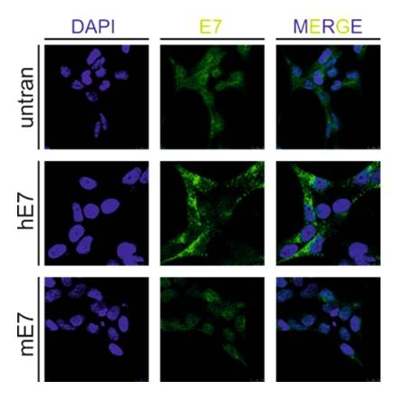
Reliatech GmbH
Rabbit anti-human EGFL7/VE-Statin
(Cat #102-PA15)
Fig. 1: Immunohistochemical staining of human and mouse EGFL7/VE-Statin in EGFL7 transfected cells. The anti-human EGFL7 antibody shows a weak cross reactivity with the mouse form.
The experiment was performed by Dr. Frank Bicker from the research group „Molecular Signal Transduction“ (Prof. Dr. Mirko H Schmidt), Institute of Microscopic Anatomy and Neurobiology, University Medical Center of Johannes Gutenberg University Mainz, Germany.
http://www.reliatech.de / orders@reliatech.de

